Slide 1
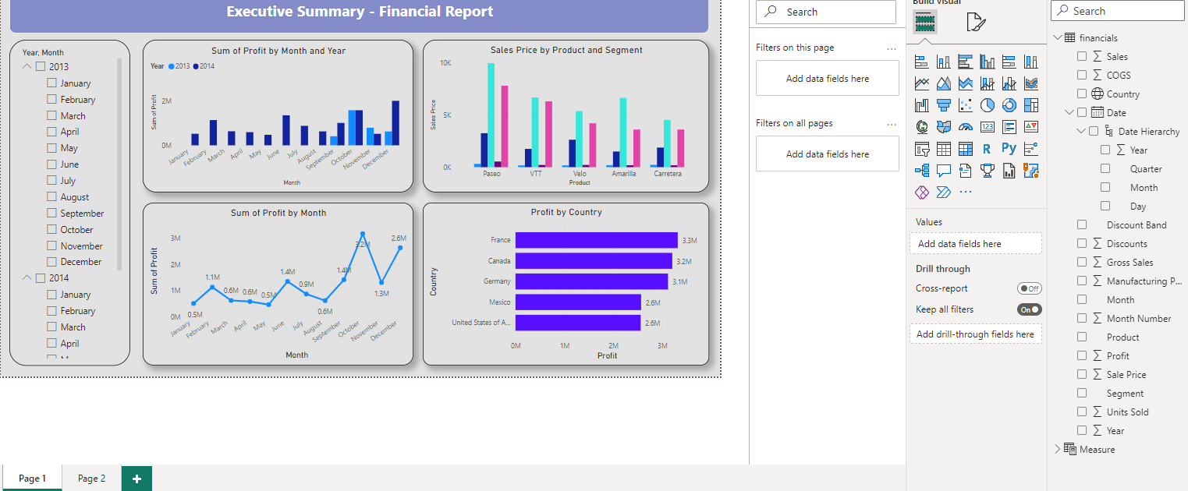
Report in Power BI Desktop

Slide 2
Download the sample
Open Power BI Desktop.
In the Data section of the Home ribbon, select Excel.
Navigate to where you saved the sample workbook, and select Open.
Prepare your data
In Navigator, you have the option to transform or load the data. The Navigator provides a preview of your data so you can verify that you have the correct range of data. Numeric data types are italicized. If you need to make changes, transform your data before loading. To make the visualizations easier to read later, we do want to transform the data now. As you do each transformation, you see it added to the list under Query Settings in Applied Steps

Slide 3
Select the Financials table, and choose Transform Data.
Select the Units Sold column. On the Transform tab, select Data Type, then select Whole Number. Choose Replace current to change the column type.
The top data cleaning step users do most often is changing data types. In this case, the units sold are in decimal form. It doesn’t make sense to have 0.2 or 0.5 of a unit sold, does it? So let’s change that to whole number.
Select the Segment column. We want to make the segments easier to see in the chart later, so let’s format the Segment column. On the Transform tab, select Format, then select UPPERCASE.
Let's shorten the column name from Month Name to just Month. Double-click the Month Name column, and rename to just Month.

Slide 4
Visual 1: Add a title
On the Insert ribbon, select Text Box. Type “Executive Summary – Finance Report”.
Select the text you typed. Set the Font Size to 20 and Bold.
Visual 2: Profit by Date
Now, you create a line chart to see which month and year had the highest profit.
From the Fields pane, drag the Profit field to a blank area on the report canvas. By default, Power BI displays a column chart with one column, Profit.
Drag the Date field to the same visual. If you created a Calendar table in Extra credit: Create a table in DAX earlier in this article, drag the Date field from your Calendar table instead.
Power BI updates the column chart to show profit by the two years.
In the Fields section of the Visualizations pane, select the drop-down in the X-axis value. Change Date from Date Hierarchy to Date.
Power BI updates the column chart to show profit for each month.
Power BI updates the column chart to show profit for each month.
Power BI updates the column chart to show profit for each month.

Slide 5
Visual 3: Profit by Country/Region
Create a map to see which country/region had the highest profits.
From the Fields pane, drag the Country field to a blank area on your report canvas to create a map.
Drag the Profit field to the map.
Power BI creates a map visual with bubbles representing the relative profit of each location.
Visual 4: Sales by Product and Segment
Create a bar chart to determine which companies and segments to invest in.
Drag the two charts you've created to be side by side in the top half of the canvas. Save some room on the left side of the canvas.
Select a blank area in the lower half of your report canvas.
In the Fields pane, select the Sales, Product, and Segment fields.
Power BI automatically creates a clustered column chart.
Drag the chart so it's wide enough to fill the space under the two upper charts.

Slide 6
Visual 5: Year slicer
Slicers are a valuable tool for filtering the visuals on a report page to a specific selection. In this case, we can create two different slicers to narrow in on performance for each month and year. One slicer uses the date field in the original table. The other uses the date table you may have created for "extra credit" earlier in this tutorial.
Date slicer using the original table
In the Fields pane, select the Date field in the Financials table. Drag it to the blank area on the left of the canvas.
In the Visualizations pane, choose Slicer.
Power BI automatically creates a numeric range slicer.
Date slicer using the DAX table
In the Fields pane, select the Date field in the Calendar table. Drag it to the blank area on the left of the canvas.
In the Visualizations pane, choose Slicer.
In the Fields section of the Visualizations pane, select the drop-down in Fields. Remove Quarter and Day so only Year and Month are left.
Now if your manager asks to see just 2013 data, you can use either slicer to select years, or specific months of each year.

Slide 7
In summary, this report answers your Interviewer top questions:
Which month and year had the most profit?
December 2014
Which country/region is the company seeing the most success in?
In Europe, specifically France and Germany.
Which product and segment should the company continue to invest in?
The company should continue to invest in the Paseo product and target the Small Business and Government segments

